Slide 1
GENE TECHNOLOGY AI & ML
Presented By
Melvin Thomas
Guided By
Ms. Phijo J Cherikkal

Slide 2
CONTENTS
INTRODUCTION
HISTORY OF GENE TECHNOLOGY
GENE TECHNOLGY
GENETICALLY MODIFIED ORGANISMS
ROLE OF AI IN GENE TECHNOLOGY
WORKING OF AI IN GENE TECHNOLOGY
AI & ML IN GENOMICS
FUTURE APPLICATIONS OF ML IN GENOMICS
PROS & CONS OF GENE TECHNOLOGY
CONCLUSION

Slide 3
INTRODUCTION
Gene Technology (Genetic Engineering) makes changes to genes.
The set of instruction in the cells of all living organisms.
Modern branch of Biotechnology allows direct modification of genes.
Organisms that are changed using gene technology called GMO.
AI algorithm understands the relation between genes, phenotypes & diseases.

Slide 4
HISTORY OF GENE TECHNOLOGY
Earlier both artificial insemination, and all the intervention of biomedical techniques in vitro fertilization (eg: test tube babies).
In 20th century the term came to refer more specifically to methods of recombinant DNA technology (gene cloning) in which DNA molecules from two or more sources are combined within cells.
The possibility of recombinant DNA technology emerged with the discovery of restriction enzymes in 1968 by Swiss microbiologist Werner Arber.
In 1973 Stanley N. Cohen and Herbert W Boyer both scientists who were among the first to cut DNA into fragments, rejoin different fragments and insert the new genes into bacteria, which then reproduced.

Slide 5
GENE TECHNOLOGY
Gene Technology or Genetic Engineering is a process that uses laboratory based technologies to alter the DNA makeup for organisms.
This technology involves changing a single base pair (A-T), deleting a region of DNA or adding a new segment of DNA.
Genetic Engineering may involve adding a gene from one species to an organism from a different species to produce a different trait.
This is much faster can be used to insert any genes form any organisms and prevents other undesirable genes form also being added.
Genetic Engineering could potentially fix severe genetic disorders in humans by replacing the defective gene with a functioning one.

Slide 6
Cont..
The DNA can be introduced directly into the host organism or into a cell that is then fused or hybridized with the host.
Genetic engineering does not normally include traditional breeding, in vitro fertilization, cell fusion techniques that do not use recombinant nucleic acids or a genetically modified organism in the process.
The organisms are changed using gene technology they are known as Genetically Modified Organisms (GMO).

Slide 7

GENETICALLY MODIFIED ORGANISMS
A genetically modified organisms is an animal, plant, or microbe whose DNA has been altered using genetic engineering techniques.
Conventional methods of modifying organisms selective breeding and cross breeding can take a long time.
The specific targeted modification of DNA using biotechnology has allowed scientists to avoid this problem and improve the genetic change of an organism

Slide 8
ROLE OF AI IN GENE TECHNOLOGY
AI has two main application in Genetics
Identification of Harmful genes:
For human beings it is time consuming process to analyze the vast amount of data that are present in a single person’s DNA.
By using ML algorithm to compare the different gene expression levels in malignant and normal tissue samples of a patient diagnosed with cancer, prediction can be made about which gene have been mutated in patient’s DNA.
AI is also being used to identify genetic mutation within tumors using 3D images. Using techniques such as Deep learning and Neural networks machine can detect the presence of mutation so that doctors can better treat the patient without the risk involved in the surgery.

Slide 9
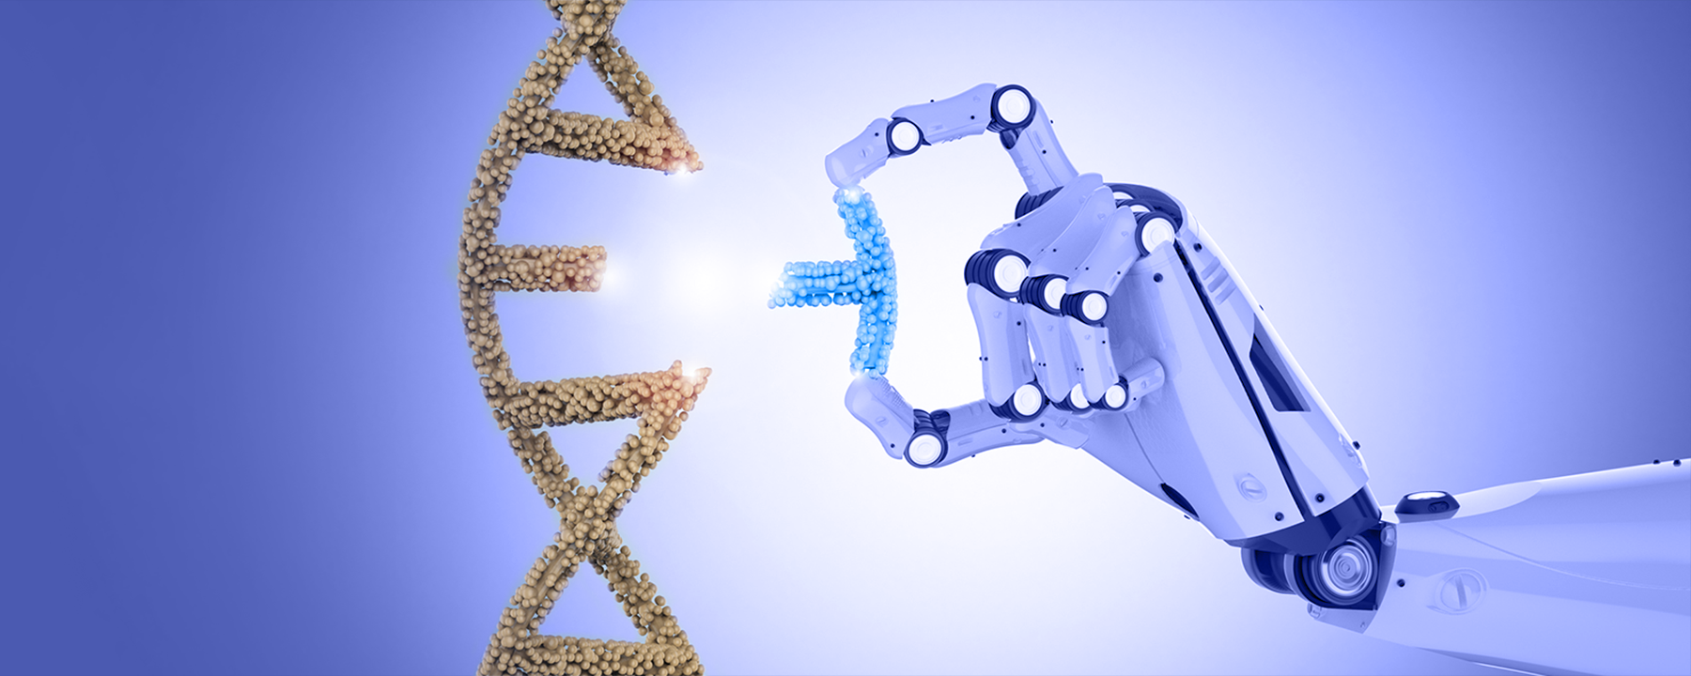
Cont..
Treatment For Diseases
A major argument in favor of gene editing is the ability to cut out disease causing genes.
ML algorithms are useful in identifying where the alteration must be made and how to ensure that the DNA strand is repaired properly.
AI is very useful is personalized medicine which requires treatments to be specified to one patient’s needs versus another.
AI can help identify which gene have been affected by harmful mutation so that they can targeted in gene therapy.

Slide 10
WORKING OF AI IN GENE TECHNOLOGY
Here is a general overview for how AI is employed in gene technology
Data Collection: Genetic data is collected through various techniques such as gene sequencing, gene expression profiling and thus this data may include gene expression level, clinical information related to disease.
Data Preprocessing: The collected genetic data is preprocessed to ensure its quality and compatibility for analysis. This may include removing noise, dealing with missing values or outliers.
Feature Extraction: AI algorithms identify relevant features or characteristics within the genetic data are associated with the desired outcomes. This process involves reducing the dimensionality of data and extracting meaningful patterns.

Slide 11
Cont..
Model Training: AI models such as ML and neural networks are trained using labelled datasets. The labelled datasets include the genetic features are linked to specific outcomes such as the disease presence or treatment.
Model Validation: The trained AI model are validated using independent datasets to evaluate their performance and ensure they can generalize to a new data.
Prediction: Once the AI model are trained and validated, they can be used to make prediction based on new genetic data.
Iterative Improvement: The AI models can be refined and improved through an iterative process.

Slide 12
AI & ML IN GENOMICS
Genome Sequencing:
Whole Genome Sequencing has grown as an area of internet in medical diagnostics.
Companies like Deep Genomics, use Machine Learning to help researchers interpret genetic variations.
Algorithms are designed based on patterns identified in large genetic data sets which are then translated to computer models to help clients interpret how genetic variation affects crucial cellular processes
Disruption to the normal functioning of these pathways can potentially cause diseases such as cancer.

Slide 13
Cont..
Gene Editing:
Gene Editing is defined as a method of making specific alterations to DNA at the cellular or organisms level.
CRISPR is a gene editing technology that offers a faster and less expensive way of conducting gene editing. In order to use CRISPR researches must first select an appropriate target sequence.
Machine Learning offers the capability to significantly reduce time , cost and effort necessary to identify an appropriate target sequence.

Slide 14
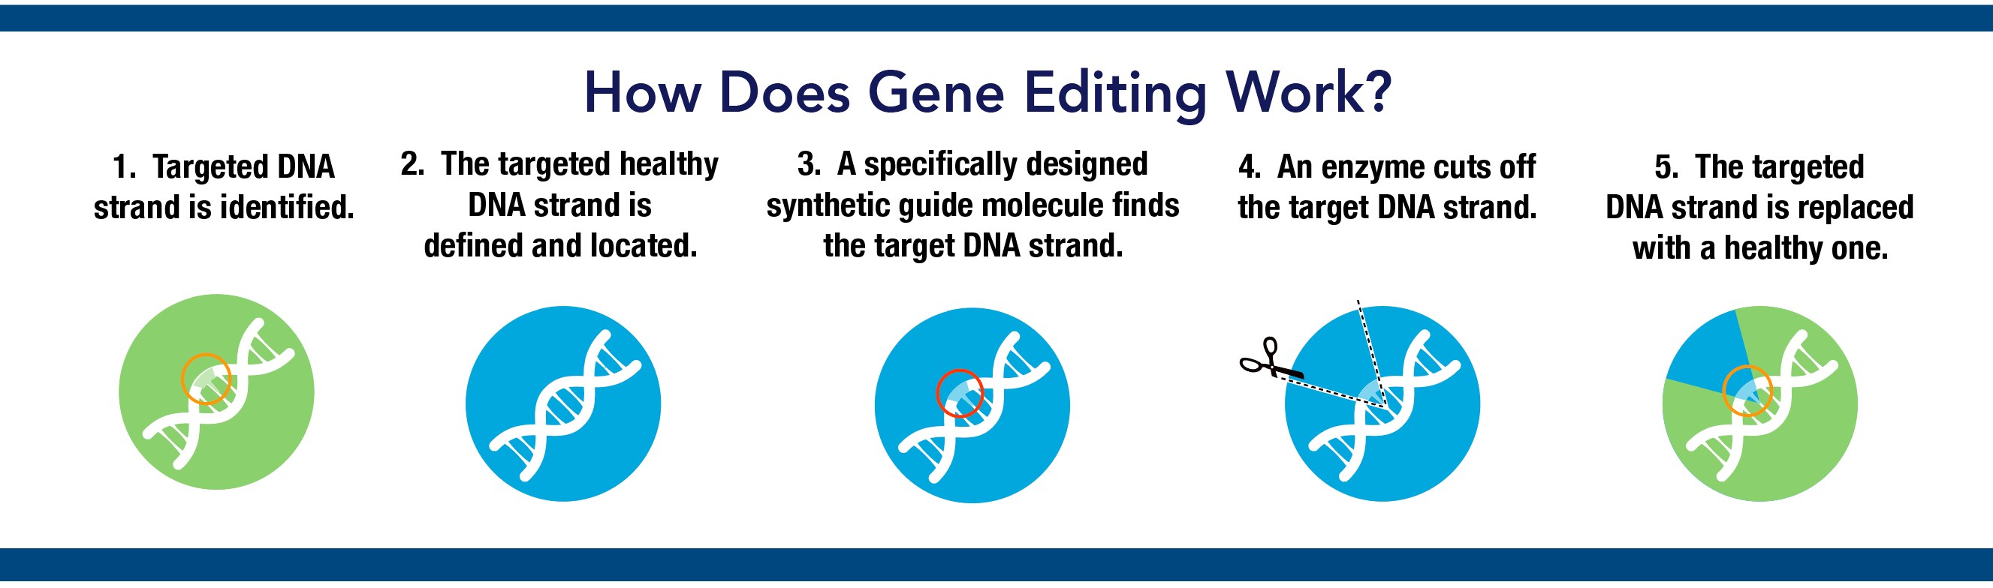
CRISPR Technology in Gene Editing:
The use of ML to predict which mutations the cell will introduce once CRISPR cuts the DNA strand.
Data was collected by analyzing over billion different gene-cutting with CRISPR and fed to an ML tool named FORECAST.
This resource could predict mutations from gene editing, thus cutting cost and reducing the time needed for gene editing.

Slide 15
FUTURE APPLICATION OF ML IN GENOMICS
Here are some of the applications of ML in Genomics:
Pharmacogenomics:
A natural progression of precision medicine, pharmacogenomics is an emerging field that looks at the role of genetics in the context of how an individual responds to drugs.
Gene technology helps in identifying potential drug targets and understanding the underlying mechanisms of drug action.
Pharmacogenomics in gene technology has the potential to revolutionize healthcare by providing personalized treatment options, improving drug efficacy, and minimizing adverse reactions.

Slide 16
Cont..
Newborn Genetic Screening Tool:
Gene technology enables the development of algorithms and software tools to analyze and interpret the genetic data efficiently.
Newborn genetic screening, also known as newborn screening or neonatal screening, is a public health program that aims to identify infants at risk for certain genetic disorders early in life.
Overall, gene technology has significantly enhanced the capabilities of newborn genetic screening, enabling the identification and early intervention for a broader range of genetic disorders, leading to improved health outcomes for infants.

Slide 17

Cont..
Agriculture:
ML algorithms can be trained on vast datasets of plant disease symptoms and pest infestations.
ML algorithms can analyze historical crop data, including genetic information, weather patterns, soil characteristics, and management practices, to predict crop yields.
ML techniques can be applied to analyze genetic and environmental data to predict crop quality attributes, such as nutrient content, taste, and texture.

Slide 18
PROS & CONS OF GENE TECHNOLOGY
PROS:
Accelerated Research: AI can analyze large scale genomic datasets and identify patterns and correlations that might be missed by human researches.
Disease Prevention & Diagnosis: AI algorithm can analyze genetic data to identify individuals at high risk of developing certain diseases.
Agricultural Advancements: Gene Technology combined with AI can enhance crop yield, nutritional content, and resistance to pests and diseases.
Genetic Engineering: AI can aid in developing and optimizing genetic modifications for various purposes such as creating disease resistant crop or developing gene therapies for genetic disorders.

Slide 19
CONS:
Data bias & Accuracy: AI algorithms heavily depend on the quality and diversity of the data they are trained on.
Complexity & Lack of Understanding: Gene Technology and AI are highly complex fields, and their intersection amplifies the complexity further.
Regulatory Challenges: Gene Technology & AI pose regulatory challenges as they often surpass existing frameworks.
Overreliance on Technology: Dependence on Gene Technology and AI could lead to overreliance, potentially overlooking alternative solutions or neglecting traditional research methods.

Slide 20
CONCLUSION
In conclusion the intersection of Gene Technology and AI holds great promise for advancements in healthcare, agriculture, and scientific research.
The utilization of AI in Gene Technology can accelerate research, enable personalized medicine, aid in disease prevention and diagnosis and improve agricultural practices.
While Gene Technology using AI offers immense potential it is crucial to strike a balance between embracing these technologies and maintaining a comprehensive approach to scientific discovery.
Ongoing research, discussions and public will play a vital role in harnessing the benefits of gene technology using AI while mitigating its risks and ethical challenges.

Slide 21



THANKS

Slide 22
